Slide 1
At Least Once
Life without Two-Phase Commit

Slide 2
Who are you?
Software Developer for more than 25 years
Stuff I care about: Messaging, EDA, Microservices, TDD, XP, OO, RDD & DDD, Code that Fits in My Head, C#
Places I have worked: DTI, Reuters, Sungard, Beazley, Huddle, Just Eat Takeaway
No smart folks
Just the folks in this room

Slide 3
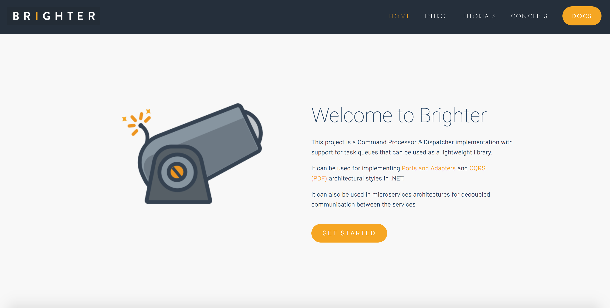

Slide 4


Slide 5
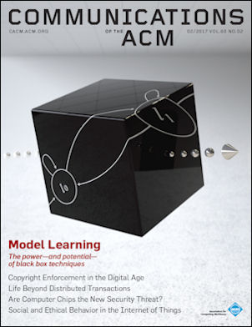
Life Beyond Distributed Transactions
By, Pat Helland 2007
Predicted
Rise of web scale stores like Cosmos and Dynamo
Container orchestration layer i.e. K8s
Led us toward Outbox and Inbox Pattern
It’s asks the question: “how do we get infinite scale”

Slide 6
Agenda
Two Phase Commit
Beyond Two Phase Commit
Entities
Messaging
At Least Once
Activities

Slide 7
Agenda
Two Phase Commit
Beyond Two Phase Commit
Entities
Messaging
At Least Once
Activities

Slide 8
You can have at most two of these properties for any shared data system
Notes:
Created by Eric Brewer According to University of California, Berkeley computer scientist Eric Brewer, the theorem first appeared in autumn 1998.^{[6]} It was published as the CAP principle in 1999^{[7]} and presented as a conjecture by Brewer at the 2000 Symposium on Principles of Distributed Computing (PODC).^{[8]} In 2002, Seth Gilbert and Nancy Lynch of MIT published a formal proof of Brewer's conjecture, rendering it a theorem.
Consistency - A read is guaranteed to return the most recent write for a given client.
Availability - A non-failing node will return a reasonable response within a reasonable amount of time (no error or timeout).
Partition Tolerance - The system will continue to function when network partitions occur.

Slide 9
Master
Mirror
A
B
myQueue
myQueue
1
1
2
C
2
3
3
1
Mirror
myQueue
2
3
Notes:
The problem with a distributed transaction
1: I try to write to the queue
2: The queue creates a transaction and writes to all the other queues in the cluster. Note that this might be in a different AZ
3: The queue then responds when the message has been written to the queue
What happens on failure to write to a node? MoM defined. RMQ for example will not guarantee, better to use publisher confirms that send you an ack when the message is written to the queue (persistent) or when it is consumed (non-persistent) and then resend when failed. Kaka lets you choose how many of your nodes is success

Slide 10
Master
Mirror
A
B
myQueue
myQueue
1
1
2
C
2
3
3
4
4
1
Mirror
myQueue
4
Notes:
The problem with a distributed transaction
1: I try to write to the queue
2: The queue creates a transaction and writes to all the other queues in the cluster. Note that this might be in a different AZ
3: The queue then responds when the message has been written to the queue
What happens on failure to write to a node? MoM defined. RMQ for example will not guarantee, better to use publisher confirms that send you an ack when the message is written to the queue (persistent) or when it is consumed (non-persistent) and then resend when failed. Kaka lets you choose how many of your nodes is success

Slide 11
On a single machine, we can forfeit partitions
Notes:
In theory a scaled up Db can forfeit partitions – because it runs on a single machine it can ignore them. But, given we are talking about how we scale beyond a single machine, we don’t get that choice, and so we need to use a distributed database that forfeits either consistency or availability

Slide 12
Forfeit Partitions
Notes:
Forfeit the ability to cope with a network partition. How is this possible? We don’t distribute i.e. an RDBMS running on a single server, or in a cluster with 2-Phase Commit for consistency.
Assumption is that we are co-located in a rack and network partitions are rare and can be retried successfully within a timeout; or the server is on fire and we don’t care

Slide 13
Unavailable
Unavailable
A
B
myQueue
myQueue
1
1
C
1
Unavailable
myQueue
Notes:
The problem with a distributed transaction
1: I try to write to the queue
2: The queue creates a transaction and writes to all the other queues in the cluster. Note that this might be in a different AZ
3: The queue then responds when the message has been written to the queue
What happens on failure to write to a node? MoM defined. RMQ for example will not guarantee, better to use publisher confirms that send you an ack when the message is written to the queue (persistent) or when it is consumed (non-persistent) and then resend when failed. Kaka lets you choose how many of your nodes is success

Slide 14
When we scale, we eventually scale out not up.
Notes:
We can’t scale up for ever/. We eventually reach the physical limits of what a machine can do. We reach that limit much sooner if cost is a factor.
So we scale out, increasing the number of nodes.
A distributed database

Slide 15
For a distributed database we can forfeit availability
Notes:
In theory a scaled up Db can forfeit partitions – because it runs on a single machine it can ignore them. But, given we are talking about how we scale beyond a single machine, we don’t get that choice, and so we need to use a distributed database that forfeits either consistency or availability

Slide 16
Forfeit Availability
Notes:
Make minority partitions unavailable.
Distributed databases tend to use this approach. Tend to work with majority consensus protocols.
Rabbit MQ is here as the Mnesia database works this way.

Slide 17
Master
Mirror
A
B
myQueue
myQueue
1
1
2
C
2
3
3
4
4
1
Unsynchronized
myQueue
4
Notes:
The problem with a distributed transaction
1: I try to write to the queue
2: The queue creates a transaction and writes to all the other queues in the cluster. Note that this might be in a different AZ
3: The queue then responds when the message has been written to the queue
What happens on failure to write to a node? MoM defined. RMQ for example will not guarantee, better to use publisher confirms that send you an ack when the message is written to the queue (persistent) or when it is consumed (non-persistent) and then resend when failed. Kaka lets you choose how many of your nodes is success

Slide 18
Let’s describe these algorithms as ones which provide global transactional serializability. Their goal is to allow arbitrary atomic updates across data spread across a set of machines.
Life Beyond Distributed Transactions - Helland

Slide 19
Agenda
Two Phase Commit
Beyond Two Phase Commit
Entities
Messaging
At Least Once
Activities

Slide 20
We cannot ‘scale infinitely’ via these approaches
Notes:
In the end we are either limited by the capacity of a single machine – where we scale up – or nodes that become inconsistent degrading our capacity

Slide 21
We are going to consider what happens when you
simply don’t do this… [Real] systems as we see them deployed today rarely even try to achieve transactional serializability across machines or, if they do, it is within a small number of tightly connected machines functioning as a cluster… which looks like one machine.
Life Beyond Distributed Transactions - Helland

Slide 22
Forfeit Consistency
Notes:
Serve data, even if it is stale. May be eventual consistency.
Web Caches
Expiration and Leases, Conflict Resolution (Etag, Last Modified, If-None-Match, If-Modified-Since)

Slide 23
Master
Mirror
A
B
myQueue
myQueue
1
1
2
C
2
3
3
4
4
1
Inconsistent
myQueue
4
Notes:
The problem with a distributed transaction
1: I try to write to the queue
2: The queue creates a transaction and writes to all the other queues in the cluster. Note that this might be in a different AZ
3: The queue then responds when the message has been written to the queue
What happens on failure to write to a node? MoM defined. RMQ for example will not guarantee, better to use publisher confirms that send you an ack when the message is written to the queue (persistent) or when it is consumed (non-persistent) and then resend when failed. Kaka lets you choose how many of your nodes is success

Slide 24
Agenda
Two Phase Commit
Beyond Two Phase Commit
Entities
Messaging
At Least Once
Activities

Slide 25
What strategies might help us cope, if we choose availability over consistency?
Notes:
In the end we are either limited by the capacity of a single machine – where we scale up – or nodes that become inconsistent degrading our capacity

Slide 26
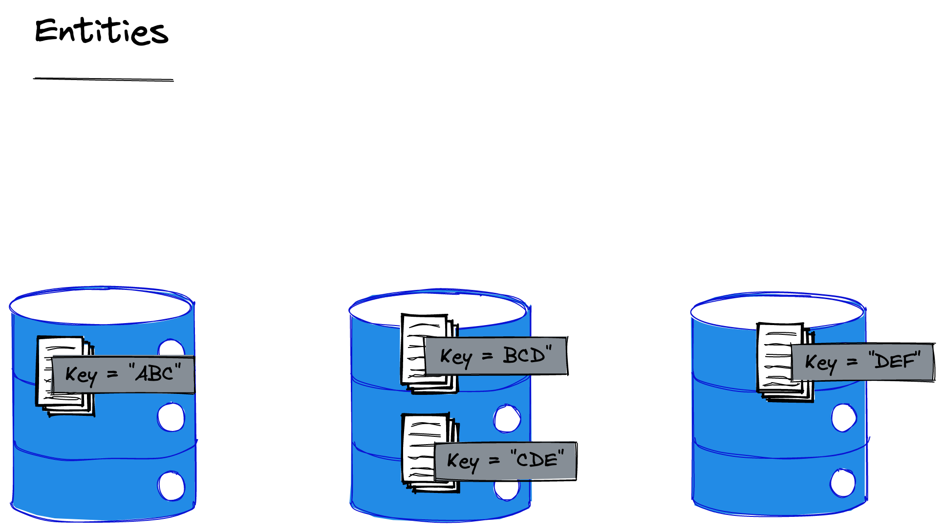
An entity can be updated atomically, because it is within a single scope.
An entity lives on one machine or scope of serializability.
An entity is a collection of data identified by a unique key.
Notes:
There are no restrictions on the size of an entity except that it must live within a single scope of serializability (i.e. one machine or cluster).
An entitykey may be of any shape, form, or flavor but it somehow uniquely identifies exactly one entity and the data contained within that entity.

Slide 27
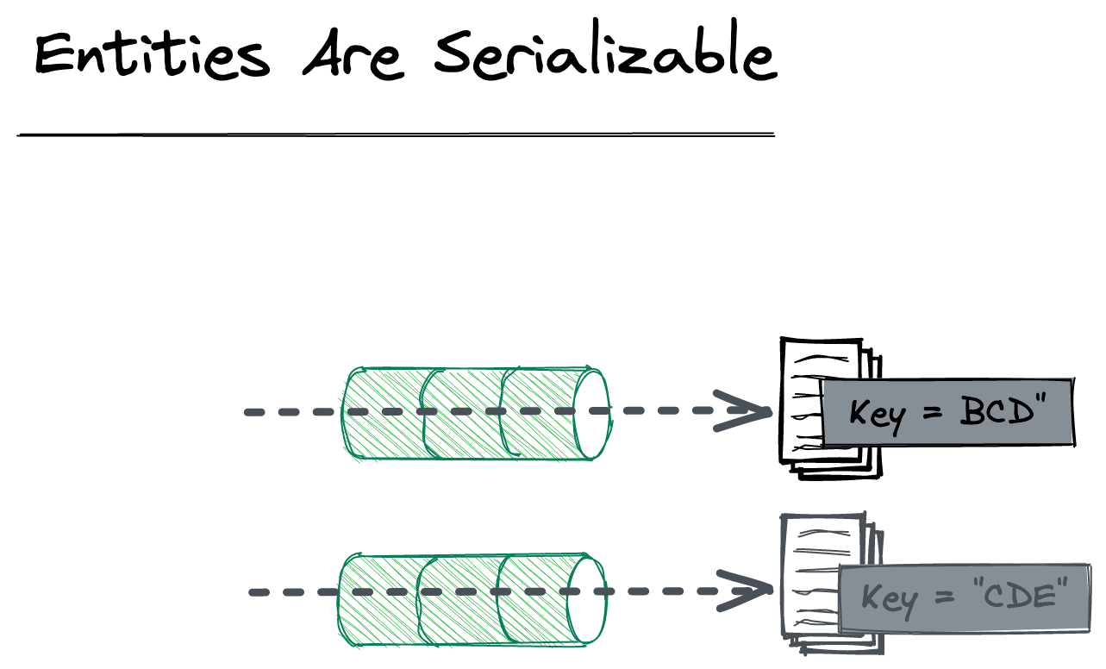

Slide 28
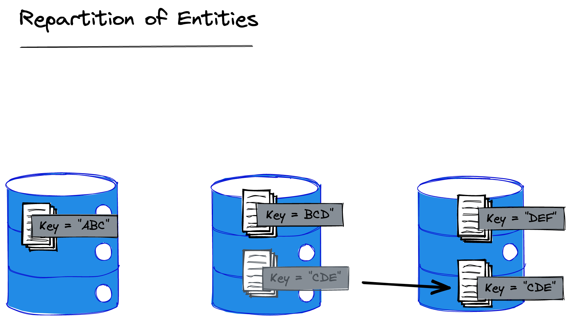
The entity store can repartition entities as it needs, so it is never safe to rely on location, and shared machine for serialization

Slide 29
We cannot know if two entities live within serialization scopes that are separated by a network partition
As a result we don’t support an atomic transaction across two entities as they may have different serialization scopes
Notes:
Because we don’t know where an entity is – we can’t create a transaction between two entities and avoid a transaction that is across partitions. By using the same key, we guarantee locality, nothing else does this. So the idea of all data related to an id, in one entity key

Slide 30
By implication we also do not offer joins between two entities when reading them because they do not necessarily share ‘locality’

Slide 31
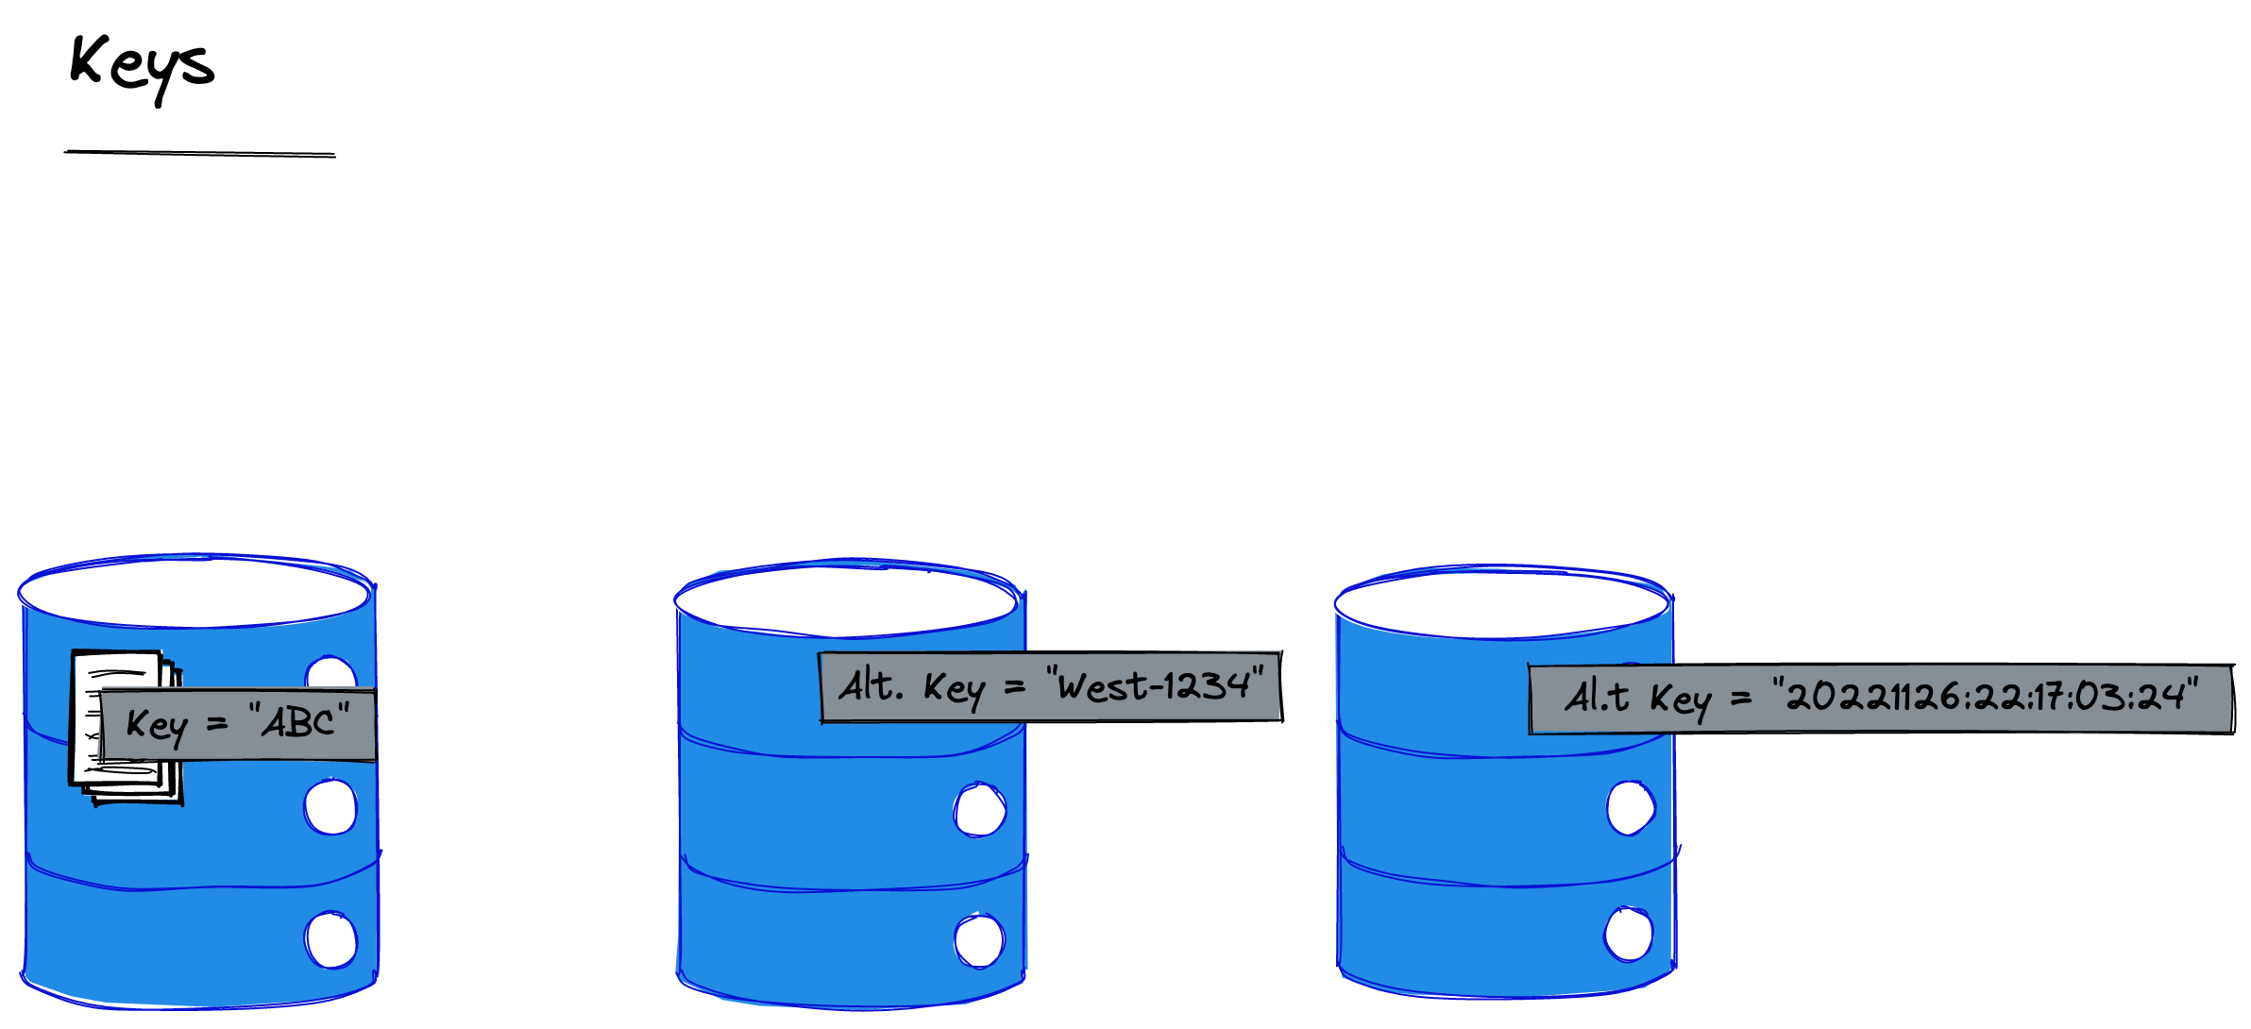
We cannot guarantee that an alternate index is maintained within the same serialization scope
We find an entity through consistent hashing of its key to its serialization scope

Slide 32
We need to lookup – accepting eventual consistency – the primary key using the alternate key
And then retrieve using that primary key

Slide 33
Agenda
Two Phase Commit
Beyond Two Phase Commit
Entities
Messaging
At Least Once
Activities

Slide 34
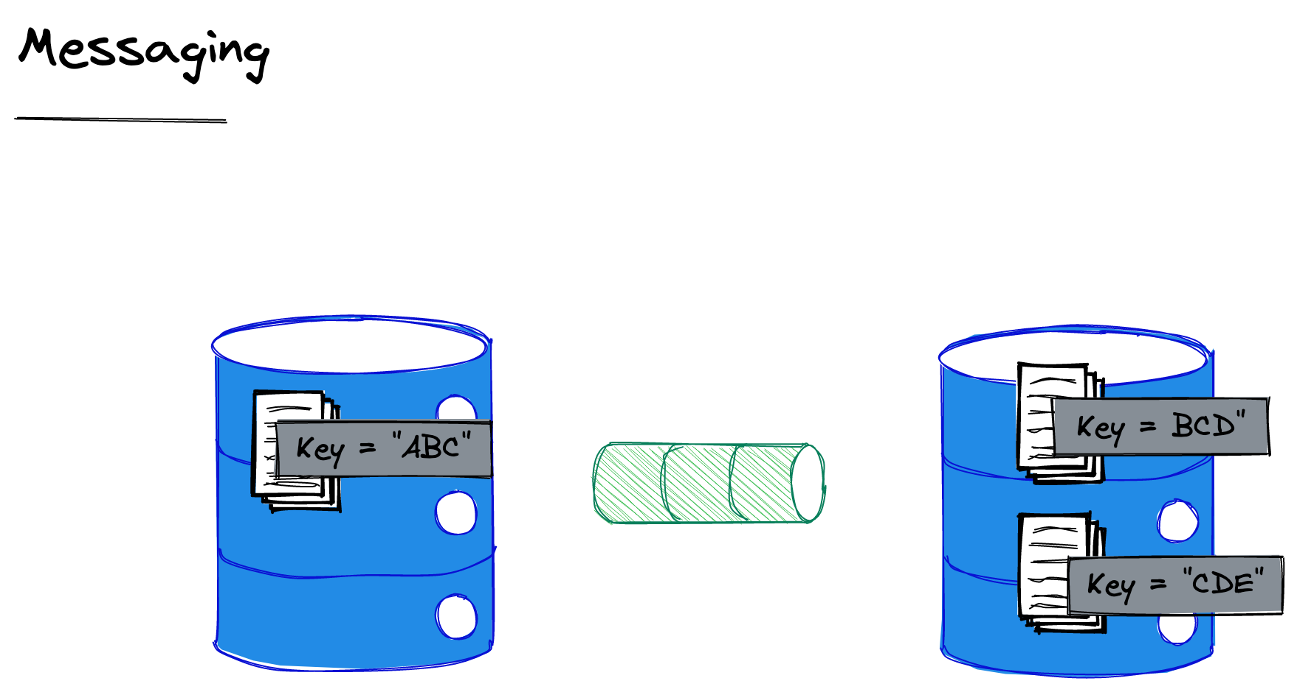
We do not use synchronous communication – which implies holding open a transaction for a response – to update multiple entities. We use messaging.
Notes:
Because we cannot have a transaction spanning two entities we do not use synchronous communication – which implies holding open a transaction for a response – to update multiple entities

Slide 35
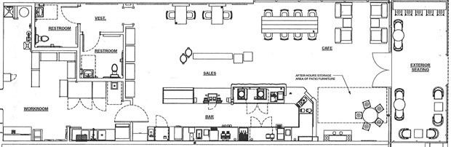
Starbucks Doesn’t Use Two Phase Commit.
Starbucks Does Not Use Two Phase Commit - Hohpe
Notes:
Starbucks uses messaging instead of

Slide 36
Agenda
Two Phase Commit
Beyond Two Phase Commit
Entities
Messaging
At Least Once
Activities

Slide 37
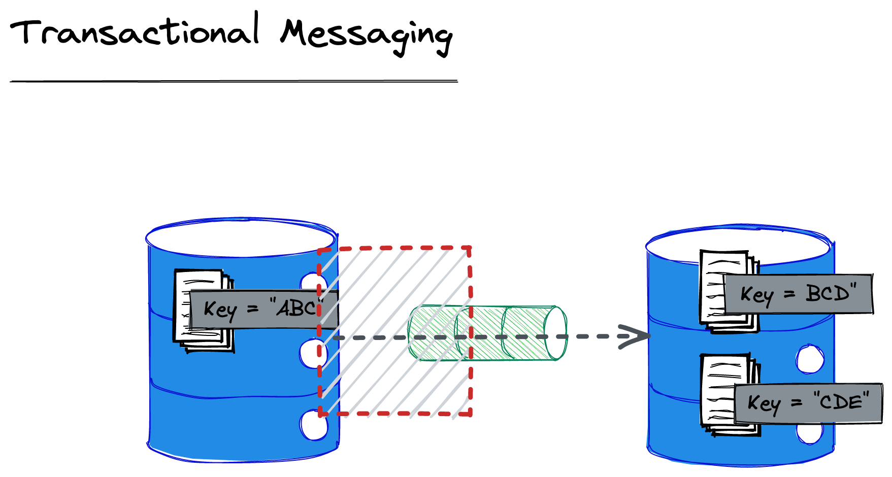
We must ensure that the message is enqueued using a transaction with the entity change, otherwise the other entity will become inconsistent because no message was sent!

Slide 38
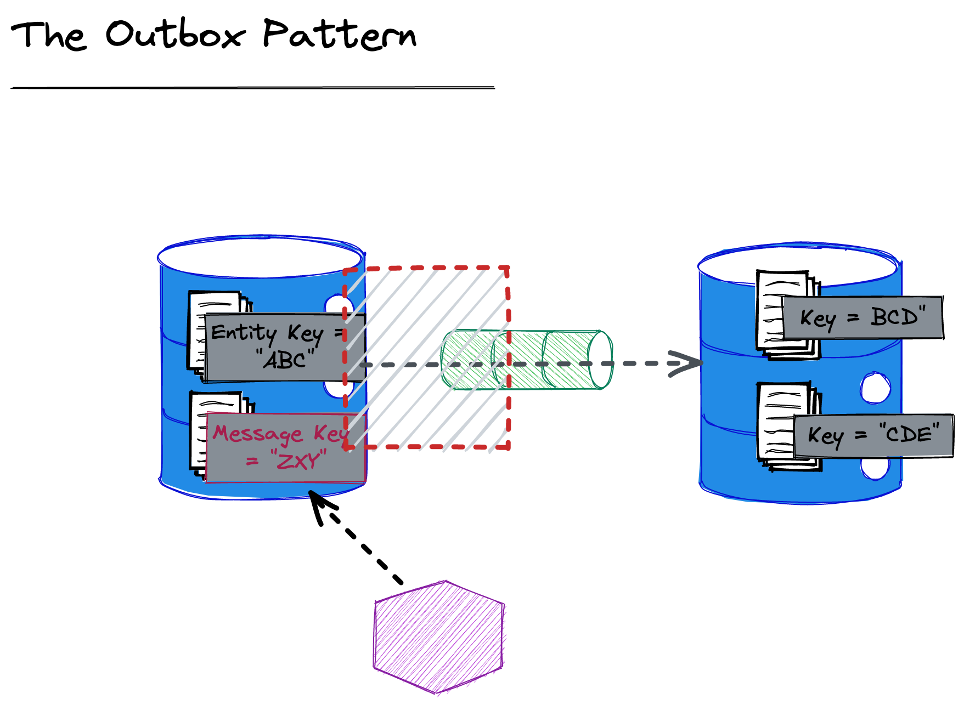
We can also send the message written immediately from the application to reduce latency (caused by the polling interval for the worker).
We are unable to create a transaction between Db and queue
We create an Outbox table and write the message we intend to send to that, in a transaction with the write with the changed/added entity
A worker looks for messages that have not been marked as sent, and sends them. It will retry until sent.
Notes:
This slide isn’t about Pat’s paper, it’s a pattern to solve the conundrum of enqueuing the message in the same transaction as the entity posed by Pat, in the absence of a transaction across queue and database.

Slide 39
We can’t know if our failure to receive an ack from the broker that a message was sent means it actually was not sent.
For this reason although we offer guaranteed delivery it is at least once, because we must resend until we get an ack.

Slide 40
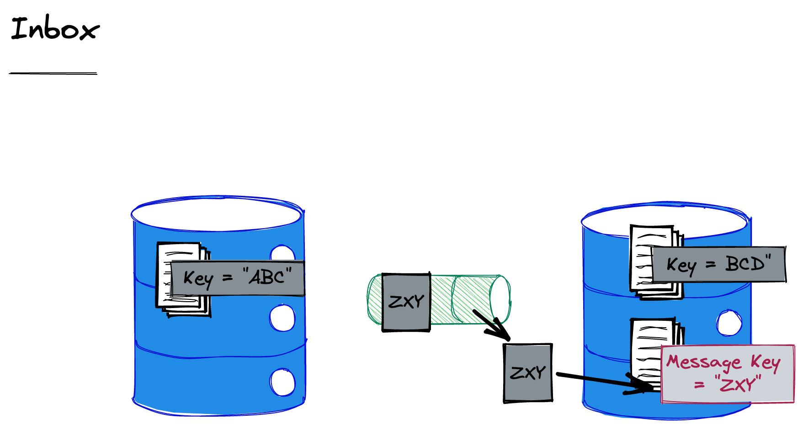
To ensure that we do not process a message twice, we record the ids of the messages that we have seen in an b and discard duplicates.

Slide 41
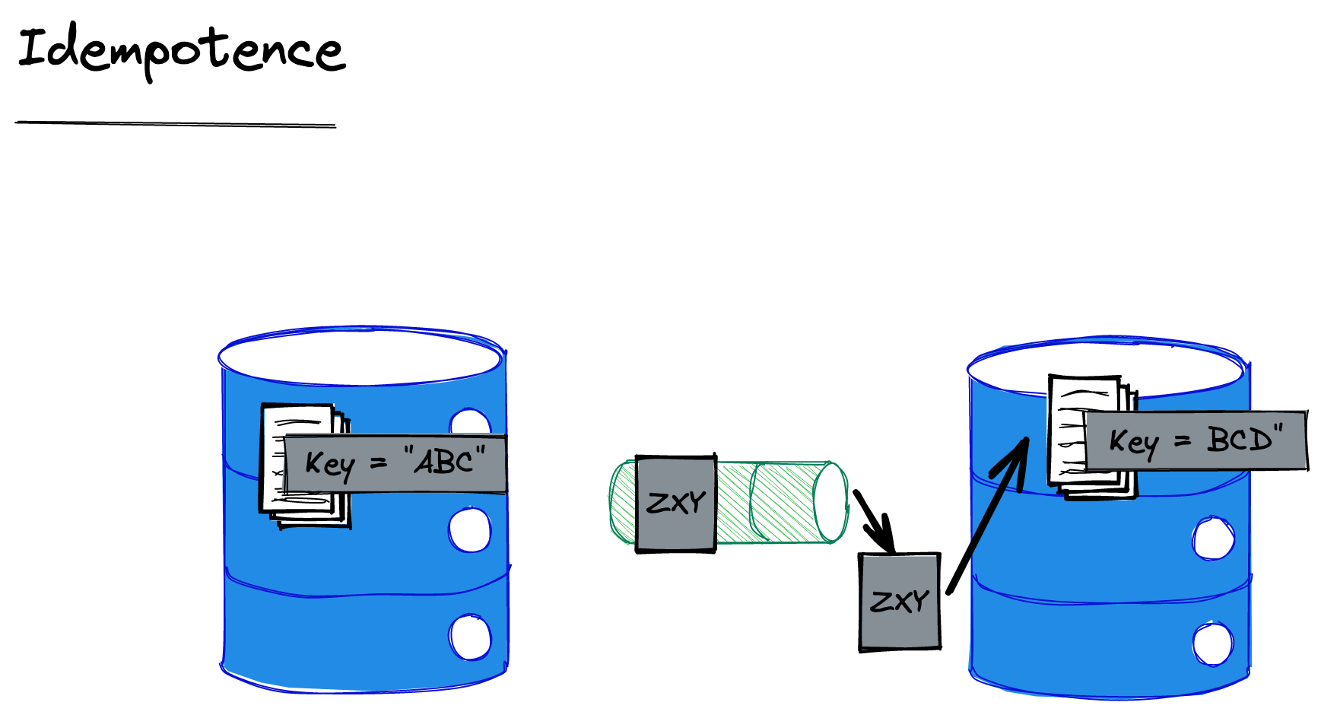
The alternative to an Inbox is idempotence. We say that a message is idempotent if reprocessing it does not carry substantive side effects.
Notes:
Substantive here is for the application to determine and is deliberately loose. But for example, writing a log would not be considered substantive in most cases.

Slide 42
Agenda
Two Phase Commit
Beyond Two Phase Commit
Entities
Messaging
At Least Once
Activities

Slide 43
How can we have a transaction between two entities here? Do we have to use 2PC between entity and message?
Notes:
Pat Helland says: “transactional enqueuing of messages is de rigueur” (actually referring to a message sent without the corresponding entity update at the source. But despite sneaking in this idea that there is a transaction around sending a message (and dequeuing a message – don’t ack until you have actioned) he does not describe how to achieve it within the limitations of “no 2PC”
If we have an activity that uses the same key as the entity we would get co-location and a transaction would be on the same cluster.
Note that if we use something like DynamoDb transactions don’t optimise for being on the same cluster node, they are just 2PC, so practically this is not necessarily a priority for most implementers

Slide 44
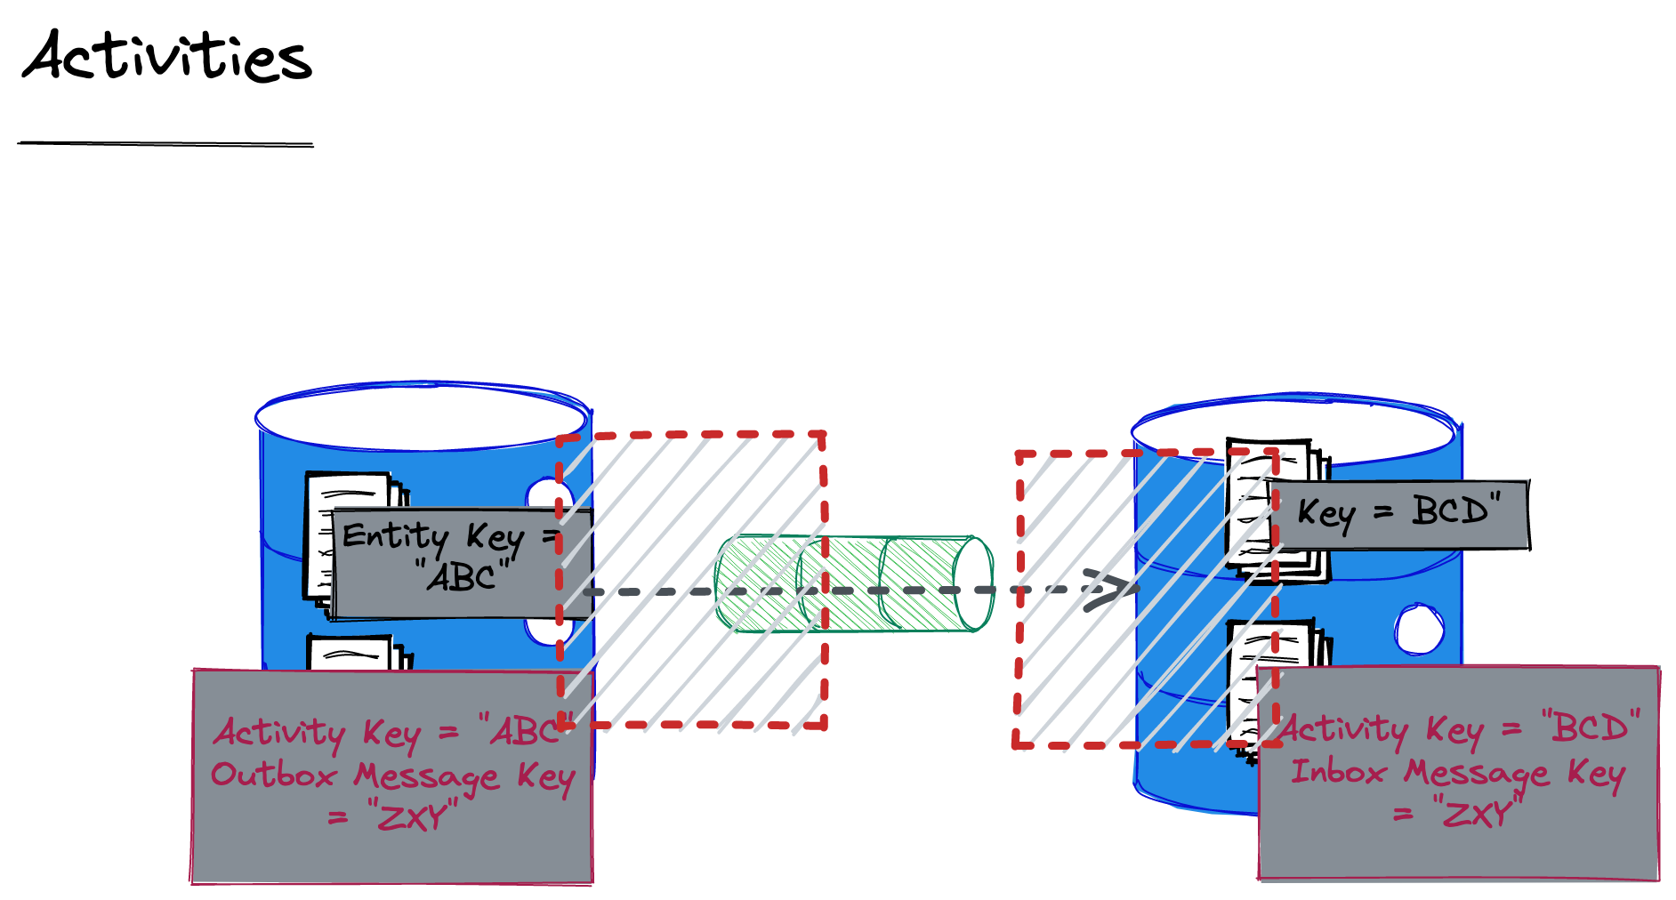
An activity has the same key as the entity, and so is stored on the same partition. Entity and activity are part of the same bubble. This allows us to scope a transaction across them
Notes:
In DynamoDb we use a primary key and a sort key. Everything associated with the entity has the same primary key, and the sort key is used to identify values within that entity.
The term bubble comes from the paper Autonomous Computing and appears later.
“Many object systems allow transaction scopes to span objects. This programmatic convenience obviates most of the challenges described in this paper. Unfortunately, that
doesn’t work under almost-infinite scaling unless your transactionally-coupled objects are always collocated. To do this, we need to assign them a common key to ensure co-location and then realize the two
transactionally-coupled objects are part of the same entity!"

Slide 45
Our Outbox is an Activity that records interaction with another entity –sending them a message
Our Inbox is an Activity that records interaction with another entity –receiving a message
Notes:
https://medium.com/ssense-tech/implementing-a-transactional-outbox-pattern-with-dynamodb-streams-to-avoid-2-phase-commits-ed0f91e69e9

Slide 46
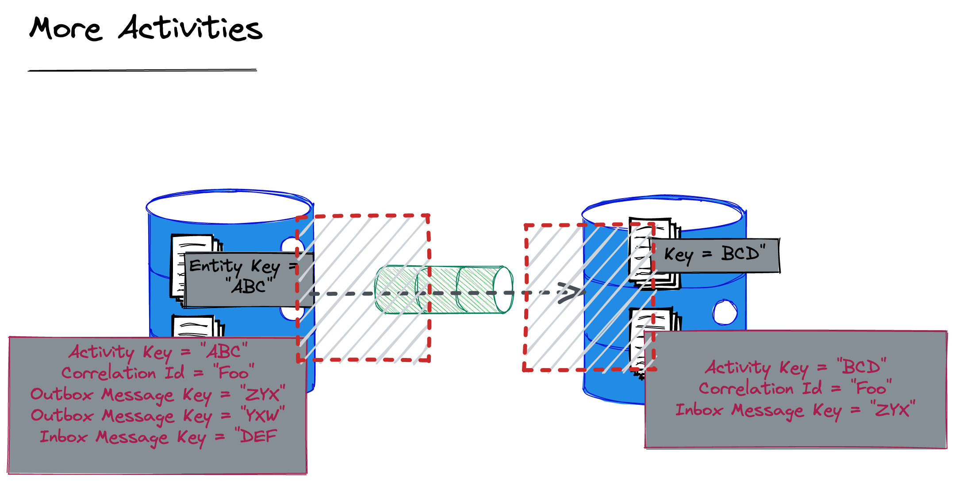
A given Activity stores the interactions for one workflow. Other workflows trigger the creation of new Activities.

Slide 47
The catch with an Activity is whether you have a DB that supports a local transaction when you write with the same entity key, as opposed to 2PC.
Notes:
DynamoDb doesn’t support this AFIAK. CosmosDb or Cassandra?

Slide 48
Agenda
Two Phase Commit
Beyond Two Phase Commit
Entities
Messaging
At Least Once
Activities

Slide 49
Q&A

